Slide 1
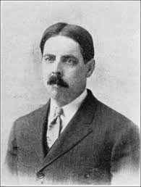

Trial and Error Theory of Learning
Wdward Lee Thorndike (1874-1949)
Presented by-
Kingshuk Karan, Assit. Prof., MGM.

Slide 2
Trial and Error Theory of Learning
Describes an organism’s attempts to learn/solve a problem by trying alternative possibilities until a correct solution or desirable outcome is achieved
Usualy involves
A number of attempts & a number of errors –before correct behaviour is learnt
Motivation (to achieve a goal)
Exploration- either random or purposeful
Reward- the correct response is rewarded-
which will lead to repeat performance of the correct response, strengthening the association between the behaviour & its outcomes
once learnt behaviour will usually be performed quickly and with fewer errors.

Slide 3
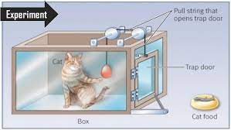
Thorndike’s Puzzle box Experiment
Thorndike put a hungry cat in a puzzle box & placed a fish just out side of the box
At first the cat to escape from the box through trial & error (random movements)
Eventually the cat accidentally pulled the string, escaped from the box so that it could reach its reinforcement(the fish)
When the cat was put back in the box, once again it went through a series of incorrect responses before pushing the lever.
The cat became progressively quicker at escaping (fewer incorrect movement)

Slide 4
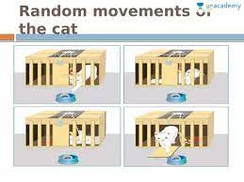

Slide 5
Factors involved in Trial and Error Theory
1. Motive or drive- it is a tension state resulting from needs. Where there is drive or motive there is learning. Here deive was hunger.
2. Stimulus or goal – it is the causal factor for activity. In the present experiment, food is the stimulus.
3. Responses- the cat makes a number of varied types of responses which lead to the goal known as satisfying responses.

Slide 6
Factors involved in Trial and Error Theory
4. Block- the cat was confirmed in the box with a closed door.
5. Chance success- as a result of random movements, the cat, by chance, succeeded in opening the door.
6. Selection of proper movement- gradually the cat selected the proper way of pulling the string out of its random movements.
7. Fixation- at last, the cat learned the proper way of opening the door by eliminating all the incorrect responses and fixing only right response.

Slide 7
Laws of Trial & Error Learning
A) Primary Laws-
1. Law of readyness- the law states that “ when any conduction unit is ready to conduct, for it to conduct is satisfying. When any conduction unit is not ready to conduct, for it to conduct is annoying.

Slide 8
Laws of Trial & Error Learning
2. Law of effect- it states that “ any behaviour that is followed by pleasant consequences is likely to be repeated, and any behaviour followed by unpleasant consequences is likely to be stopped”.

Slide 9
Laws of Trial & Error Learning
3. Law of exercise- the law states that repeated exercising of a response strengthens its connection with the stimulus. And connection is weakened through failure of practice.

Slide 10
Laws of Trial & Error Learning
B) Secondary Laws
1. law of multiple response
2. law of attitude
3. law of analogy
4. Law of associative shifting

Slide 11
Educational Implications
1. Motivation is very important in the teaching-learning process.
2. Learning should be made purposeful and goal directed.
3. Theory stresses the importance of mental readiness, meaning practice and intensive in learning process.

Slide 12
Educational Implications
4. More opportunities should be given to the learners to use and repeat the knowledge they get in the classroom.
5. The learner should be encouraged to do his task independently. He must try various solutions of the problem before arriving at the correct one

Slide 13
Thank You

